Slide 1
MESEARCH
Search Engine
Manisha Pathak
Disha Bisht
Debajyoti Nag

Slide 2
What is a Search Engine???

Slide 3
INTRODUCTION
search for information on the World Wide Web.

Slide 4
HOW DOES IT WORK???

Slide 5
Search Engines operate in the following order :

Slide 6
WEB CRAWLER

Slide 7
INDEXING
Parse
Collect
Store

Slide 8
SEARCHING/QUERYING
User query.
They vary greatly from standard query languages, which are governed by strict syntax rules as command languages with keyword or positional parameters.

Slide 9
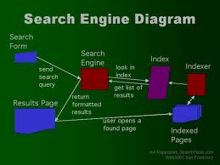

Slide 10
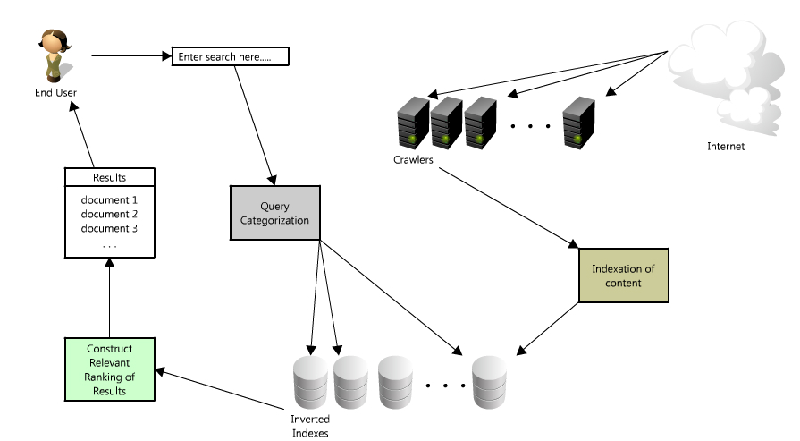

Slide 11
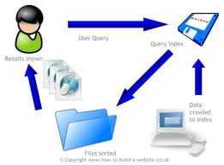
Select any one diagram

Slide 12
Working/output

Slide 13
SOFTWARE /HARDWARE USED
Python
IDLE-2.7.2
xampp Server -1.7.7
Notepad++ for html

Slide 14
THANK YOU

